Slide 1
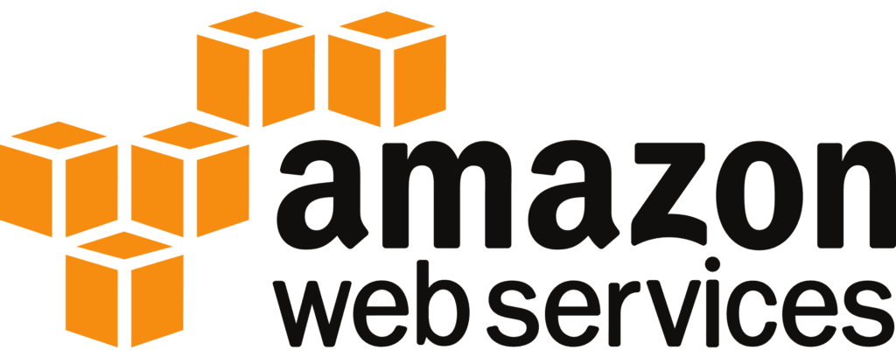

NAT GATEWAY

Slide 2


AGENDA
What is NAT Gateway?
How NAT Gateway works?
Types of NAT Devices
Use Cases
Key Features
NAT Gateway Vs. NAT Instance
Benefits
Conclusion

Slide 3
What is NAT Gateway?
Network Address Translation Gateway
Definition:
A NAT Gateway is a service that allows instances in a private subnet to connect to the internet or other AWS services while preventing incoming traffic from the internet from directly reaching those instances.
Purpose:
Provides secure internet connectivity for resources in a private subnet without exposing them to inbound traffic from external sources.

Slide 4
How NAT Gateway Works
Key Concept: Network Address Translation (NAT) is a method that maps private IP addresses to a public IP address, allowing outbound traffic to the internet while blocking unsolicited inbound connections.
Process: When an instance in a private subnet initiates an outbound connection to the internet, the NAT Gateway translates the instance’s private IP address to a public IP address, allowing the traffic to flow.
The NAT Gateway maintains a state table to map the internal private IPs to the external public IP, ensuring responses return to the correct instance.
No Inbound Traffic: The NAT Gateway does not allow unsolicited inbound connections, making it more secure for resources that should not be directly accessible from the internet.

Slide 5


Types of NAT Devices
A manually configured EC2 instance used to provide NAT services.
Requires manual scaling, patching, and updates.
NAT INSTANCE:
NAT GATEWAY:
A fully managed service offered by cloud providers like AWS.
Highly available, automatically scales to handle traffic, and reduces the administrative overhead.

Slide 6
NAT Gateway Use Cases
Private Subnets in VPCs: Instances in private subnets need to access external services (e.g., downloading software updates or connecting to external APIs) without exposing themselves to public access.
Security: Ensures that sensitive resources (like databases, backend servers) can securely interact with the internet while maintaining strong security boundaries.
Access to AWS Services: NAT Gateways are often used to allow instances in private subnets to interact with other AWS services (S3, DynamoDB) over the internet without exposing these instances to direct internet access.

Slide 7
Key Features of NAT Gateway
High Availability: NAT Gateway is a highly available service managed by cloud providers. In AWS, it spans multiple Availability Zones (AZs) to ensure redundancy.
Scalability: Automatically scales to handle large amounts of traffic without user intervention.
Managed Service: Reduces the need for configuration and management, unlike NAT Instances, which require manual scaling, patching, and monitoring.
Cost: Charges are based on data processed and duration the gateway is active, but it's simpler and more cost-effective compared to managing NAT Instances at scale.

Slide 8
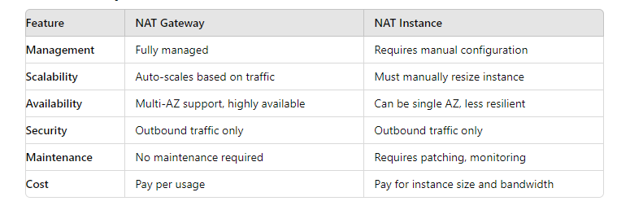
NAT Gateway vs. NAT Instance

Slide 9
Security Considerations
No Inbound Access:
NAT Gateway allows outbound traffic only, meaning instances in private subnets remain secure and isolated from external threats.
Control with Security Groups:
Control traffic flow to/from instances using security groups or network ACLs (Access Control Lists).

Slide 10
Benefits of NAT Gateway
Reduced Administrative Overhead:
As a managed service, NAT Gateway reduces the need for ongoing maintenance compared to NAT instances.
Cost-Effective:
Eliminates the need to manage EC2 instances and manually scale or maintain NAT infrastructure.
Simplified Architecture:
Easy integration with Virtual Private Cloud (VPC) designs, offering a secure and scalable solution for outbound internet traffic.

Slide 11
NAT Gateway provides a scalable, secure, and managed way for instances in private subnets to communicate with the internet while blocking unsolicited inbound traffic. It is highly available, automatically scales, and is a critical component in cloud networking architectures.
CONCLUSION

